Slide 1
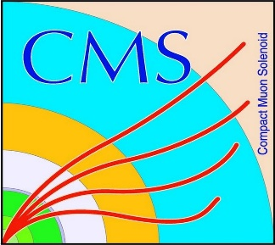

HEP Weekly Report
George Bakas
NTUA

Slide 2
Progress Report
DCS
fwInstallationUtils
Using the dbEditorAndNavigator tool to create projects using installations db
Want to implement ownership rights when using the tool
Progress on the tool
Now all projects, computers, systems and groups are monitored for each specific user when using the tool
Several changes in the panels and scripts to implement tool
Tool is ready→ Testing for flaws
Analysis
Top Tagger efficiency, signal/bkg
Trying to find why the output of the Mtt sample is so different from the nominal Signal sample
Reached out to the Top ModGen experts to check what are the exact cuts in the Mtt Sample
Working progress
Top-18-013 Analysis
New binning for some variables
Studying the AN for the pre approval (?)

